Slide 1

Lecture 2: Supervised Learning and Neural Networks
Hands on Artificial Intelligence and Robotics
Lingxiao Wang, Ph.D.
Assistant Professor of Electrical Engineering
Louisiana Tech University

Slide 2
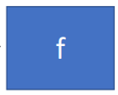


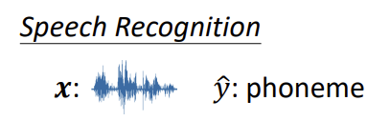
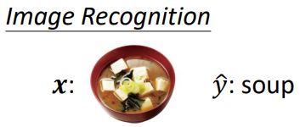
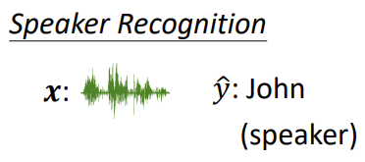
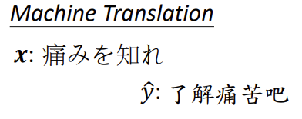


Framework of Machine Learning
Objective of Machine Learning:
Find the function with provided inputs and outputs.
Training Data (exposed to the function):
Testing Data (unseen/new data to the function):
Example Applications:
$$x$$
$$y$$

Slide 3
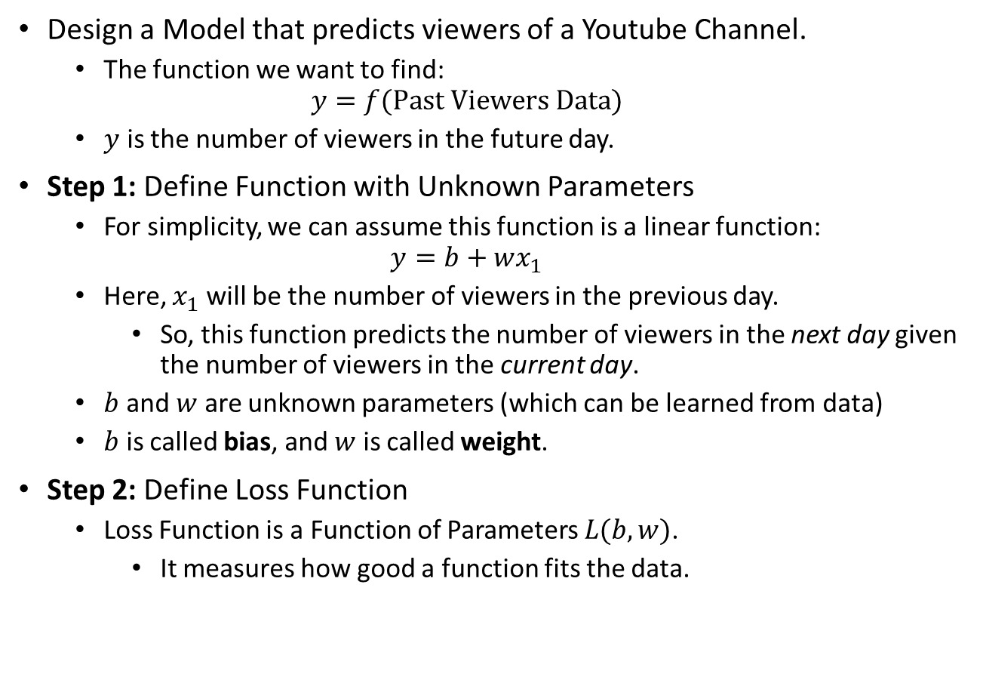
Example: Predict Viewers per Month of a Youtube Channel
Design a Model that predicts viewers of a Youtube Channel.
The function we want to find:
$$y=f(Past Viewers Data)$$
$y$ is the number of viewers in the future day.
Step 1: Define Function with Unknown Parameters
For simplicity, we can assume this function is a linear function:
$$y=b+wx_{1}$$
Here, $x_{1}$ will be the number of viewers in the previous day.
So, this function predicts the number of viewers in the next day given the number of viewers in the current day.
$b$ and $w$ are unknown parameters (which can be learned from data)
$b$ is called bias, and $w$ is called weight.
Step 2: Define Loss Function
Loss Function is a Function of Parameters $L(b,w)$.
It measures how good a function fits the data.

Slide 4
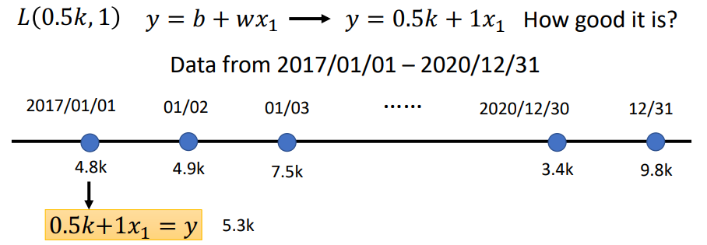
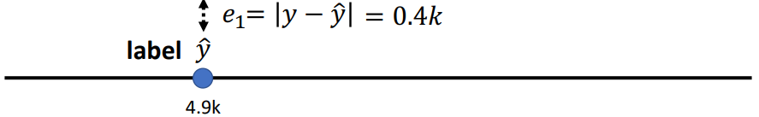

Step2 : Define Loss Function
For instance, $b=0.5k; w=1$ (here $k=1000$).
Use the function to make a prediction
Compare the result with label data

Slide 5
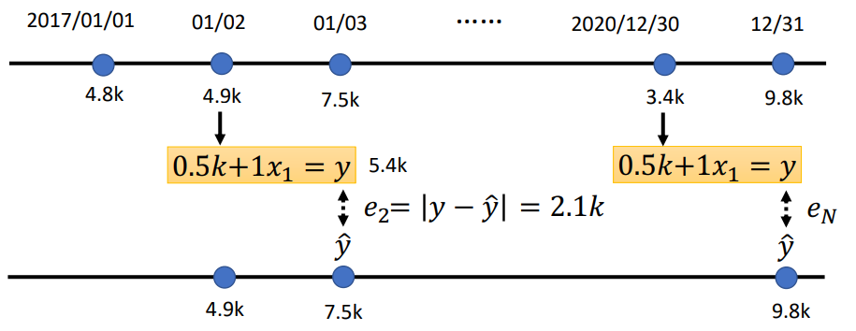

Step2 : Define Loss Function
Continue the comparison for other dates:
The difference between the prediction (i.e., the function output) and the label data is the loss.
Two possible loss definitions:
Mean absolute error (MAE): $e=|y−\hat{y}|$
Mean square error (MSE): $e={\left(y−\hat{y}\right)}^{2}$

Slide 6
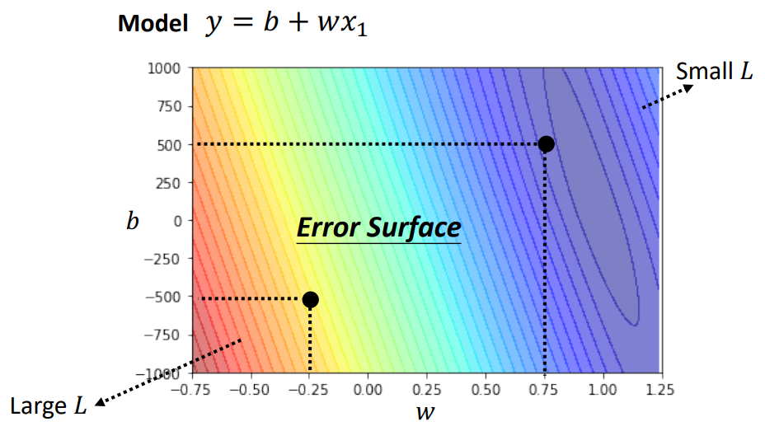

Step2 : Define Loss Function
By iterating all possible $b$ and $w$ (within a range) and the corresponding loss function result, we can get an Error Surface
The red area indicates large loss values; the blue area indicates small loss values.
Our goal is to find a set of parameters that gives us small loss (i.e., function prediction is close to the truth data).

Slide 7





Step 3: Optimization
The goal of the optimization is to choose a set of parameters that gives a small loss.
A commonly used method is called Gradient Descent.
Gradient Descent:
Start by picking an initial value (i.e., $b_{0}, w_{0}$)
Then, compute the gradient of $\frac{∂L}{∂b}$ and $\frac{∂L}{∂w}$
Update the value of $b_{0}$ and $w_{0}$ in the direction that reduces $L$
Loss
$$L$$
$$w^{0}$$
$$w$$

Slide 8
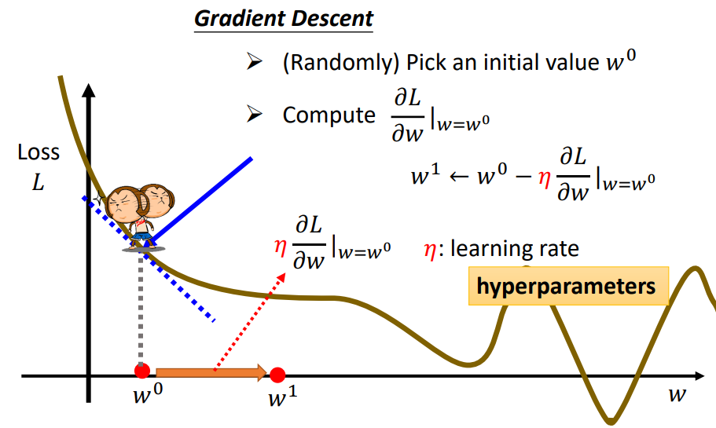



Step 3: Optimization
Update $w^{0}$
Use learning rate to adjust update step
Obtain a new $w$, $w^{1}$
Repeat this process at the new $w$

Slide 9
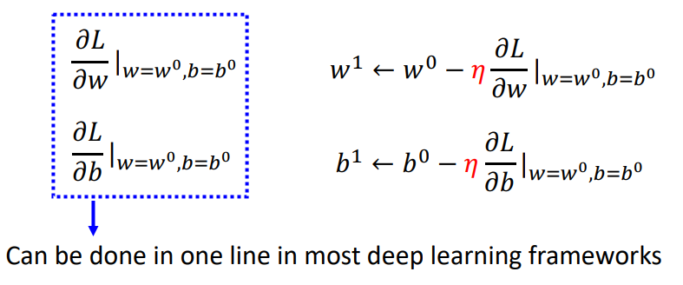


Step 3: Optimization
Thus, Gradient Descent can be summarized as follows:
Pick Initial Values $w^{0}, b^{0}$
Compute
Update $w$ and $b$ iteratively until the loss is small enough.

Slide 10
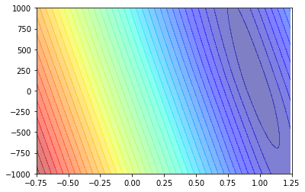


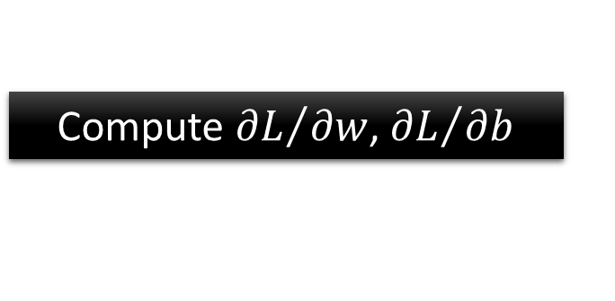
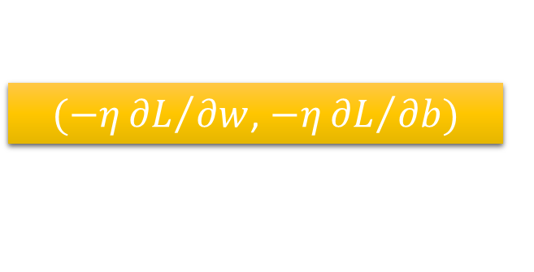





Step 3: Optimization
Model
$$y=b+wx_{1}$$
$$w^{∗},b^{∗}=arg\min_{w,b}{L}$$
Compute ${∂L}/{∂w}$, ${∂L}/{∂b}$
$$w^{∗}=0.97,b^{∗}=0.1k$$
$$b$$
$$L\left(w^{∗},b^{∗}\right)=0.48k$$
$(−η{∂L}/{∂w}$, $−η{∂L}/{∂b})$
Compute ${∂L}/{∂w}$, ${∂L}/{∂b}$
$$w$$

Slide 11
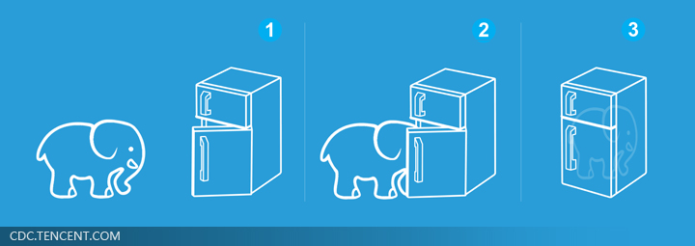




Supervised Learning is Simple
Step 1: function with unknown
Step 2: define loss from training data
Step 3: optimization
$$w^{∗}=0.97,b^{∗}=0.1k$$
$$y=b+wx_{1}$$
$$MAE or MSE$$
$$L\left(w^{∗},b^{∗}\right)=0.48k$$

Slide 12
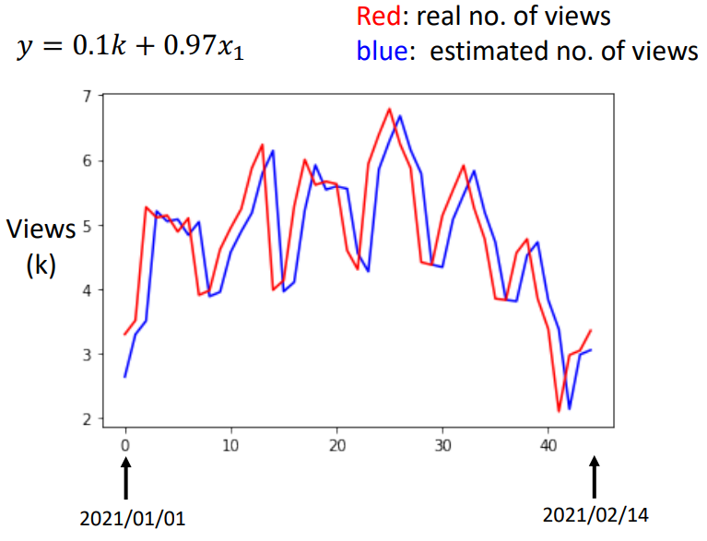
Results for Viewer Prediction
We can see that the prediction is not so well.
How to improve?
We can make the function more complex.

Slide 13
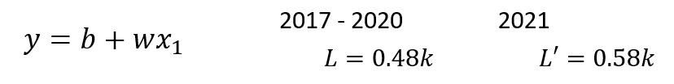
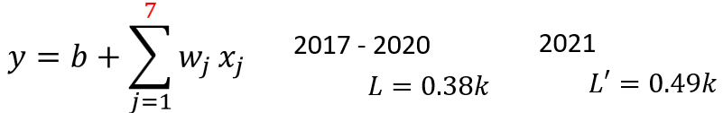
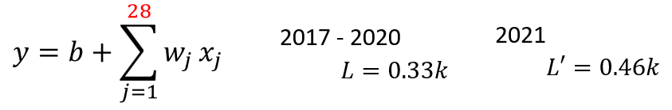
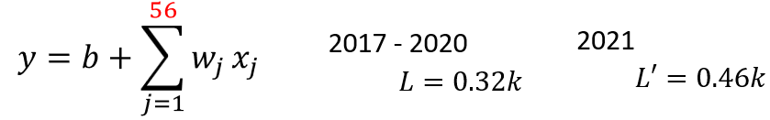

Make the Function More Complex
One way to make the function more complex is adding more features
For instance, instead of taking only the number of viewers for the current day as input, we can consider the past 7 days.
In other words, we can add more features to the function.
Training Data
Testing Data
$L′$ does not decrease with the increase of features.
This is because the linear model is too simple!

Slide 14
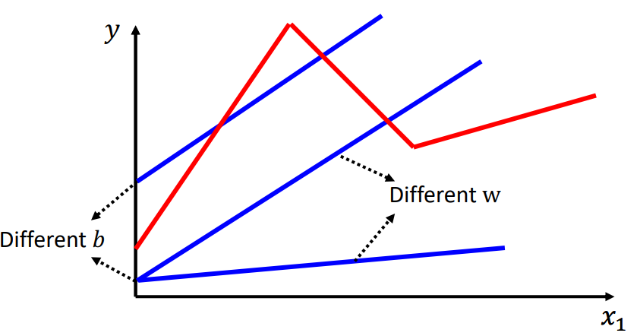
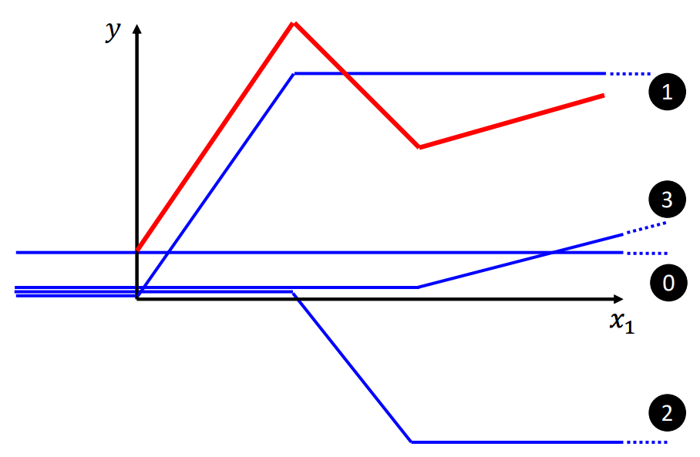


Make the Function More Complex
Linear model is too simple
Maybe the true function is not linear (such as the red line)
We need more flexible model.
The desired curve (i.e., the red line) can be made by:
How to make ?

Slide 15
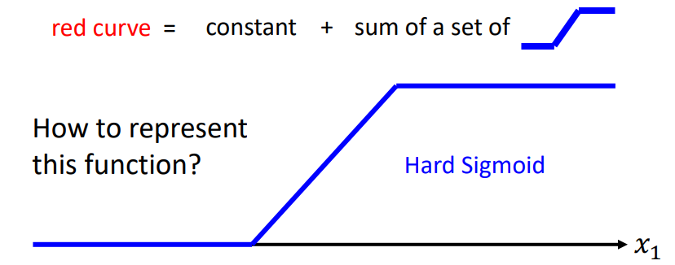
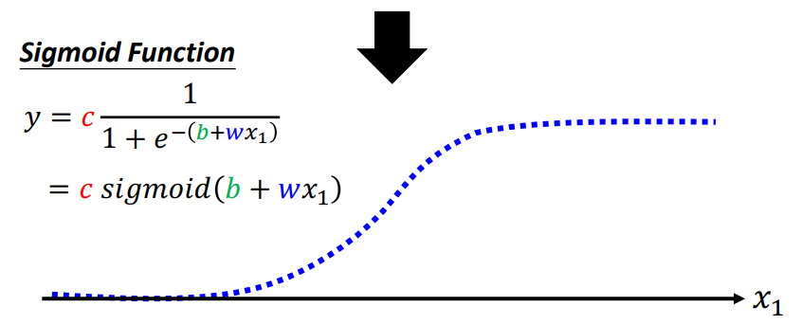
Make the Function More Complex

Slide 16
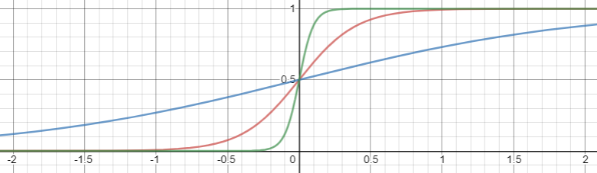
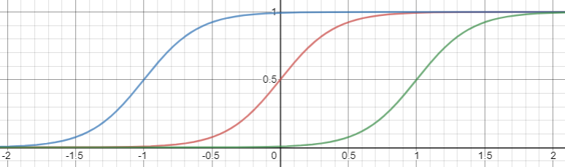
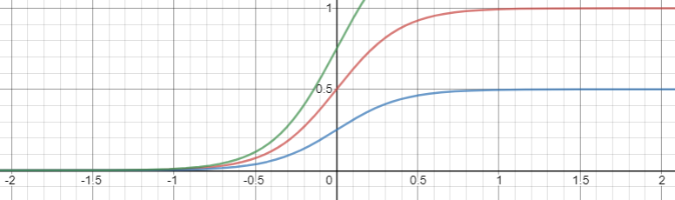
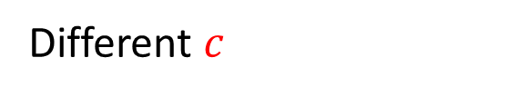
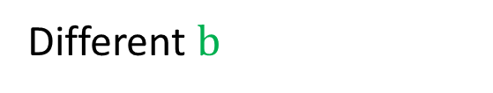
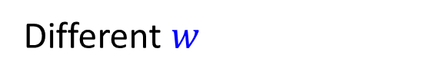
Different $w$
Change slopes
Different $b$
Shift
Different $c$
Change height

Slide 17






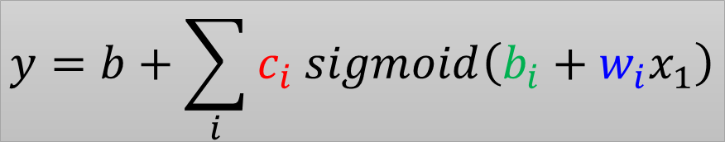
red curve =
sum of a set of
+ constant
$$y$$
$$c_{1} sigmoid\left(b_{1}+w_{1}x_{1}\right)$$
1
$$c_{3} sigmoid\left(b_{3}+w_{3}x_{1}\right)$$
3
0
$$x_{1}$$
$$y=b+\sum_{i}{c_{i} sigmoid\left(b_{i}+w_{i}x_{1}\right)}$$
$$x_{1}$$
0
1
+
2
+
3
$$c_{2} sigmoid\left(b_{2}+w_{2}x_{1}\right)$$
2
Notes:
How to fit this one?
The summation of the blue functions is the green one.

Slide 18
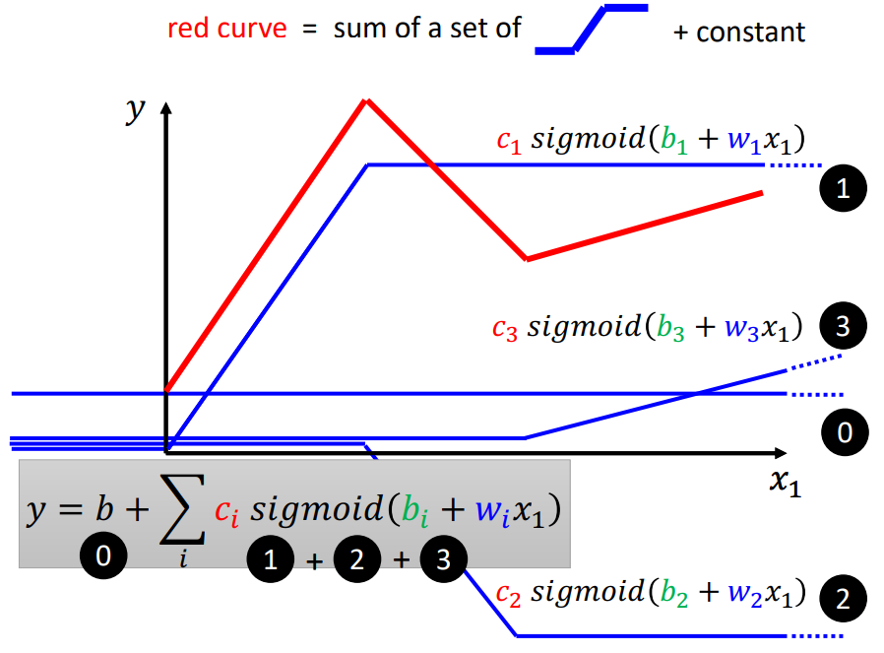
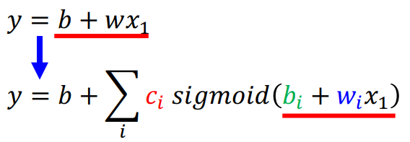
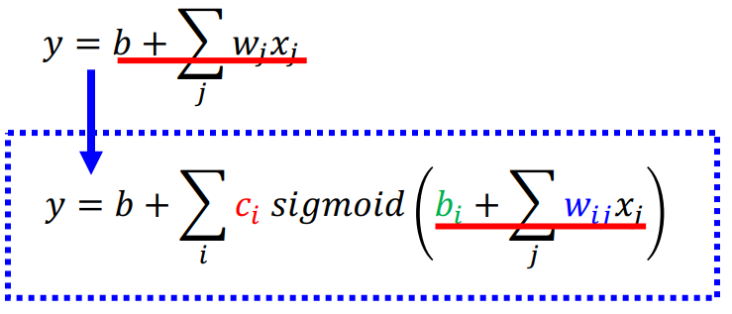
Make the Function More Complex
1,2,3 are the set of piecewise elements, made by sigmoid function.
0 is the bias
Single Feature
Multiple Features

Slide 19


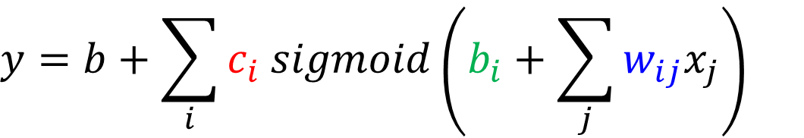














$$y=b+\sum_{i}{c_{i} sigmoid\left(b_{i}+\sum_{j}{w_{ij}x_{j}}\right)}$$
$$j:1,2,3$$
no. of features
$$i:1,2,3$$
no. of sigmoid
1
$$r_{1}=$$
$$b_{1}+w_{11}x_{1}+w_{12}x_{2}+w_{13}x_{3}$$
+
$$w_{11}$$
$$b_{1}$$
$$w_{12}$$
$$x_{1}$$
$w_{ij}$: weight for $x_{j}$ for i-th sigmoid
1
$$w_{13}$$
2
$$x_{2}$$
$$r_{2}=$$
$$b_{2}+w_{21}x_{1}+w_{22}x_{2}+w_{23}x_{3}$$
+
1
$$x_{3}$$
3
$$r_{3}=$$
$$b_{3}+w_{31}x_{1}+w_{32}x_{2}+w_{33}x_{3}$$
+
1

Slide 20
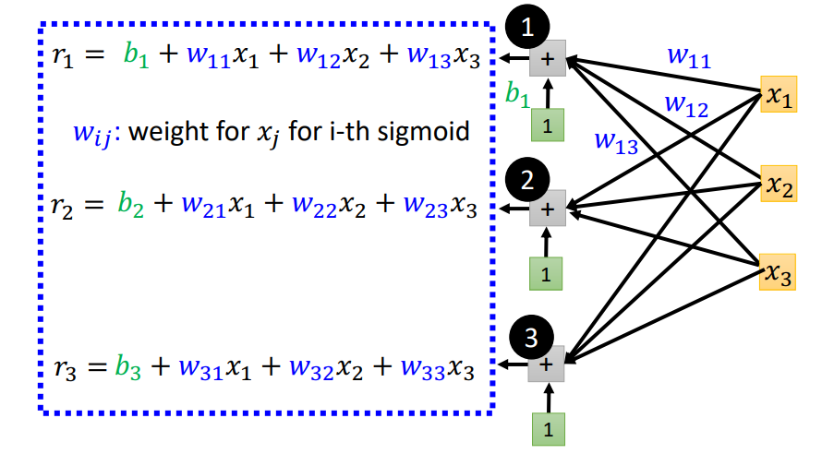
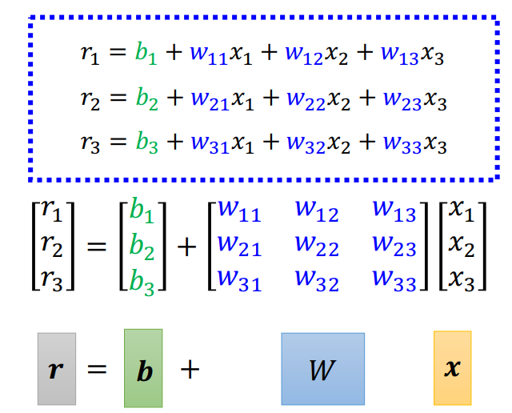
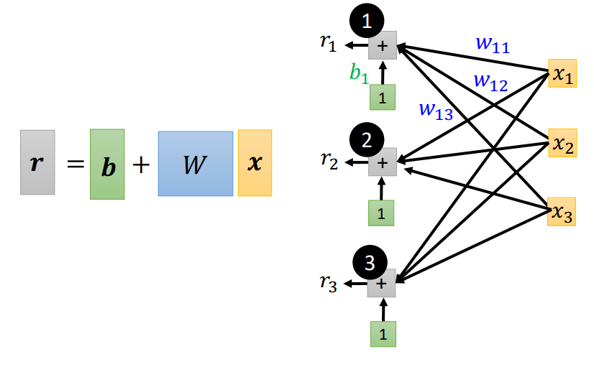
Make the Function More Complex
In the matrix form:

Slide 21








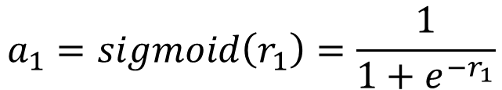



$$y=b+\sum_{i}{c_{i} sigmoid\left(b_{i}+\sum_{j}{w_{ij}x_{j}}\right)}$$
$$i:1,2,3$$
$$j:1,2,3$$
1
$$a_{1}$$
$$r_{1}$$
+
$$w_{11}$$
$$a_{1}=sigmoid\left(r_{1}\right)=\frac{1}{1+e^{−r_{1}}}$$
$$b_{1}$$
$$w_{12}$$
$$x_{1}$$
1
$$w_{13}$$
2
$$x_{2}$$
$$a_{2}$$
$$r_{2}$$
+
1
$$x_{3}$$
3
$$a$$
$$=σ\left( \right)$$
$$a_{3}$$
$$r_{3}$$
$$r$$
+
1

Slide 22










$$y=b+\sum_{i}{c_{i} sigmoid\left(b_{i}+\sum_{j}{w_{ij}x_{j}}\right)}$$
$$i:1,2,3$$
$$j:1,2,3$$
1
$$a_{1}$$
$$r_{1}$$
+
$$w_{11}$$
$$c_{1}$$
$$b_{1}$$
$$w_{12}$$
$$x_{1}$$
1
$$w_{13}$$
$$c_{2}$$
2
$$x_{2}$$
$$y$$
+
$$a_{2}$$
$$r_{2}$$
+
$$b$$
1
$$x_{3}$$
1
$$c_{3}$$
3
$$a_{3}$$
$$r_{3}$$
+
$$y$$
$$=$$
$$b$$
+
$$c^{T}$$
$$a$$
1

Slide 23
























1
$$a_{1}$$
$$r_{1}$$
+
$$w_{11}$$
$$c_{1}$$
$$b_{1}$$
$$w_{12}$$
$$x_{1}$$
1
$$w_{13}$$
$$c_{2}$$
2
$$x_{2}$$
$$y$$
+
$$a_{2}$$
$$r_{2}$$
+
$$b$$
1
$$x_{3}$$
1
$$c_{3}$$
3
$$a_{3}$$
$$r_{3}$$
+
$$=$$
+
$$a$$
1
$$y$$
$$b$$
$$c^{T}$$
$$a$$
$$=σ\left( \right)$$
$$r$$
$$=$$
$$+$$
$$W$$
$$x$$
$$r$$
$$b$$

Slide 24





1
$$a_{1}$$
$$r_{1}$$
+
$$w_{11}$$
$$c_{1}$$
$$b_{1}$$
$$w_{12}$$
$$x_{1}$$
1
$$w_{13}$$
$$c_{2}$$
2
$$x_{2}$$
$$y$$
+
$$a_{2}$$
$$r_{2}$$
+
$$b$$
1
$$x_{3}$$
1
$$c_{3}$$
3
$$a_{3}$$
$$r_{3}$$
+
1
$$y$$
$$=$$
+
+
$$W$$
$$x$$
$$σ\left( \right)$$
$$b$$
$$c^{T}$$
$$b$$

Slide 25
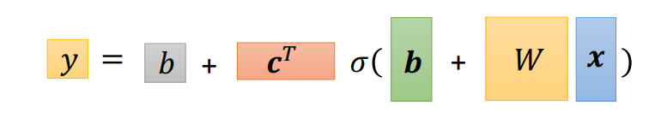








Back to Machine Learning Framework
Now we define a universal function $y$that can represent an arbitrary function with proper parameter values.
Here, $x$ is the feature vector (i.e., inputs).
$W, b, c^{T}, b$ are unknown parameters.
Next, we define the loss from training data.
Step 1: function with unknown
Step 2: define loss from training data
Step 3: optimization
$$y$$
$$=$$
+
+
$$W$$
$$x$$
$$σ\left( \right)$$
$$b$$
$$c^{T}$$
$$b$$

Slide 26
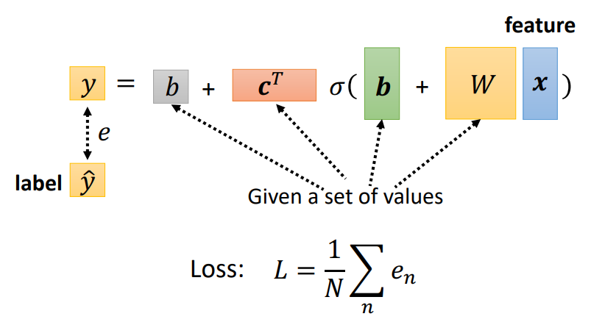


Loss Function
Recall that loss function is a function of parameters $L(θ)$
Here, we use $θ$ to represent all unknown parameters, i.e., $W, b, c^{T}, b$ in the previous page.
Loss function measures how good a set of parameters is.
You can use either MAE or MSE to compute $e$ (check page 5).
$$θ$$

Slide 27



Optimization of New Model
Once we have the function with unknown parameters and loss, we can need to optimize the function to fit the training data.
We can use gradient descent to find the optimal parameters $θ^{∗}$
Procedures of gradient descent are presented as follows:
Here, $η$ is a hyper-parameter, called learning rate.
You need to choose an appropriate learning rate to make the training stable and effective.

Slide 28




Optimization with a Batch
We usually use a batch to accelerate the training process.
Suppose that we have $N$ pieces of data and divide $N$ into multiple batches.
Each batch contains $B$ pieces of data.
Then, instead of using the entire $N$ data to compute the loss $L$, we compute the loss for each batch to get $L^{1}, L^{2},L^{3}….$
Thus, the procedures of gradient descent becomes:
1 update = see a single batch
1 epoch = see all the batches

Slide 29



Sigmoid -> ReLU
We can also use other functions to represent
Such as the Rectified Linear Unit (ReLU).
Thus, the expression of $y$ can be changed to:
We need 2 ReLU to make a

Slide 30

Make the Function More Flexible
Experiment Results:
The table below shows the loss of function prediction on viewers of a Youtube Channel on training (2017-2020) and testing data (2021), respectively.
We can see that with the increase of ReLU function, the loss on training data decreases, but not a significant improvement on testing data.
Adding more ReLU function (i.e., activation function) is adding more unknown parameters to make the function more flexible.
We can also make the function to contain more layers.

Slide 31


Make the Network Deeper: Add More Layers
We can even add more layers to make the network to include more unknown parameters:
Old model with one layer
New model with two layers

Slide 32



Make the Network Deeper: Add More Layers
Experiment Results
The table below shows the loss for a model with multiple layers:
100 ReLU for each layer
2017-2020 is the training data; 2021 is the testing data
We can observe that the loss decreases for both training and testing data.
Multi-layer ReLU Model
Linear Model

Slide 33

Neural Network
We name the function with unknown parameters as Neural Network, which includes:
Activation function -> Neuron
Hidden Layers (layers that are not input or output)
If the model contains multiple layers -> Deep Learning Model.
Deep indicates that the network contains multiple layers.

Slide 34



Framework of Machine Learning
Training Data:
Training Procedures:
Step 1: define the function with unknown parameters (i.e., define the neural network)
Step 2: define the loss function based on the training data
The loss function measures how well the function prediction is.
Step 3: define the optimization function
Testing Data:

